Slide 1
Module 09
World Models & Goal-Directed Behavior
How does the brain simulate the future — and can a machine do the same?
ITAI 4374: Neuroscience as a Model for AI
Houston City College • AI & Robotics Program • Spring 2026

Slide 2
Where We Are in the Journey
✓
Module 02: COMPUTE — What does the brain compute?
✓
Module 03: BUILD — Brain anatomy & neurons
✓
Module 04: CONNECT — Spiking neural networks
✓
Module 05: SENSE — Sensory processing & perception
✓
Module 06: REMEMBER — Memory & learning
✓
Module 07: ATTEND & AWARE — Attention & consciousness
✓
Module 08: DECIDE — Decision making & dopamine
▶
Module 09: SIMULATE — World models & goal-directed behavior
2

Slide 3
You Catch the Ball Before It Arrives
Your eyes see the ball 300ms ago. But your hand is already in position.
The brain did not react — it PREDICTED.
Your brain simulates where the ball WILL BE and moves
your hand to that spot before the ball arrives.
Think of a baseball outfielder: the ball is still in the air, but
the player is already running to where it will land.
Perception is prediction. The brain runs a movie of the future.
3

Slide 4
The Problem: Neural Signals Are Slow
Speed of neural signal: ~70 m/s
Distance from eye to visual cortex: ~15 cm
Processing time: 150–200ms
By the time you "see" something, it happened in the past.
Solution: predict the present from past patterns.
Analogy: It's like watching a live sports stream with a 3-second delay.
Your brain compensates by guessing what's happening NOW.
You live 200ms in the past. Your world model lives in the present.
4

Slide 5
PART 1
How the Brain Builds a World Model

Slide 6
Karl Friston’s Big Idea
The Brain as a Prediction Machine
Analogy: The News Editor
Every second, your brain generates predictions about what sensory input it EXPECTS to receive.
It sends these predictions DOWN from higher cortex to lower sensory areas.
Only ERRORS travel upward.
Instead of printing everything, the editor only publishes what’s SURPRISING.
If you predicted it, it doesn’t make headlines.
Your brain works the same way — routine data gets filtered out. Only surprises get attention.
The brain is not a camera. It is a hypothesis generator.
6

Slide 7
What Happens When You’re Wrong
The Coffee Cup
The Familiar Route
The Magician
You reach for your coffee — it’s lighter than expected. Your arm jerks up.
You drive a familiar route and miss your exit because you were on autopilot.
A magician makes a coin ‘disappear.’ Your prediction is violated — you gasp.
Prediction error: weight model was wrong
Too-good prediction suppressed awareness
Surprise = large prediction error
Learning IS the process of correcting prediction errors.
7

Slide 8
Minimizing Surprise Karl Friston’s Unified Theory
"Surprise" in the brain = statistical improbability of what just happened given your model.
Free Energy ≈ How wrong your model is.
Two strategies to reduce surprise:
1. PERCEIVE — Update your model to fit reality. (Learning)
2. ACT — Change reality to fit your model. (Active Inference)
All behavior — from blinking to breathing to building a business — is surprise minimization.
8

Slide 9
Acting to Confirm Your Predictions
Normal view: "I want coffee → I pick up the cup."
Active inference view: "My model predicts I will feel the cup in my hand → I reach to make that prediction true."
Perception
Updates beliefs to match reality
Action
Changes reality to match beliefs
"The brain doesn’t react to the world. It acts to confirm its story about the world."
9

Slide 10
⚠ Misconception: "Doesn’t the Brain WANT Surprises?"
"Wait — I love surprises! How can the brain want to MINIMIZE surprise?"
Answer: The brain wants EXPECTED surprises.
A good movie has twists you didn’t see coming but that make sense in hindsight.
True surprise (random noise) is aversive.
Expected-but-uncertain (curiosity) is rewarding.
Curiosity = seeking information that WILL reduce surprise.
The brain seeks to be surprised in the ways it already expects to be surprised.
10

Slide 11
The Brain’s Internal Simulator
The brain does not just react — it SIMULATES.
Hippocampus: Mental time travel. You can visit your childhood home right now — in your mind.
Cerebellum: Simulates the physics of your movements milliseconds before you execute them.
Prefrontal Cortex: Simulates future scenarios for decision making.
Imagination is just your world model running forward without acting.
11

Slide 12
Brain Regions as World Model Components
HIPPOCAMPUS
CEREBELLUM
PREFRONTAL CORTEX
Long-term spatial/episodic simulator.
"Where have I been? Where could I go?"
Physics engine for motor actions.
"If I throw at this angle/force, where will the ball land?"
Planning simulator.
"If I do X, what happens next? What about Y?"
Like GPS memory + replay
Like a fast game engine
Like a chess engine
12

Slide 13
PART 2
World Models in Artificial Intelligence

Slide 14
Ha & Schmidhuber (2018): World Models
Two researchers asked: "What if an AI agent learned to dream?"
V — Visual Model Variational Autoencoder: Compress raw visual input into a compact representation
M — Memory Recurrent Neural Network: Predict what happens next based on sequence
C — Controller Small neural net that makes decisions using only the compact world model — not raw input
The agent trains entirely in its own dream. Then wakes up and acts in the real world.
14

Slide 15
Training in Imagination
1
Explore the real environment briefly (collect some experience)
2
Train the World Model (V+M) on that experience
3
Train the Controller in the DREAM (running the World Model instead of the real environment)
4
Deploy in the real world
Why this is powerful: You need 1,000× less real-world experience.
Analogy: A chess grandmaster plays most of their games in their head, not on a real board.
15

Slide 16
Two Roads to Learning
MODEL-FREE
MODEL-BASED
Trial and error only. No internal map.
"I’ll figure it out as I go."
Example: Classical conditioning
Pros: Simple
Cons: Needs millions of trials
Build a map, then plan. Simulate before acting.
"Let me think before I move."
Example: Chess engine, GPS navigation
Pros: Sample-efficient
Cons: Computationally expensive
Which does the brain use? BOTH — depending on situation and familiarity.
16

Slide 17
World Models You Already Know
AlphaZero (DeepMind)
DreamerV3 (DeepMind)
MuZero
Plays chess, Go, Shogi at superhuman level. Trained entirely by playing against itself — using its own world model.
Learns in latent dream space. Masters Atari games, Minecraft, robot control from the same algorithm.
Learns the rules AND the values without being told the game rules. Pure model-based learning.
17

Slide 18
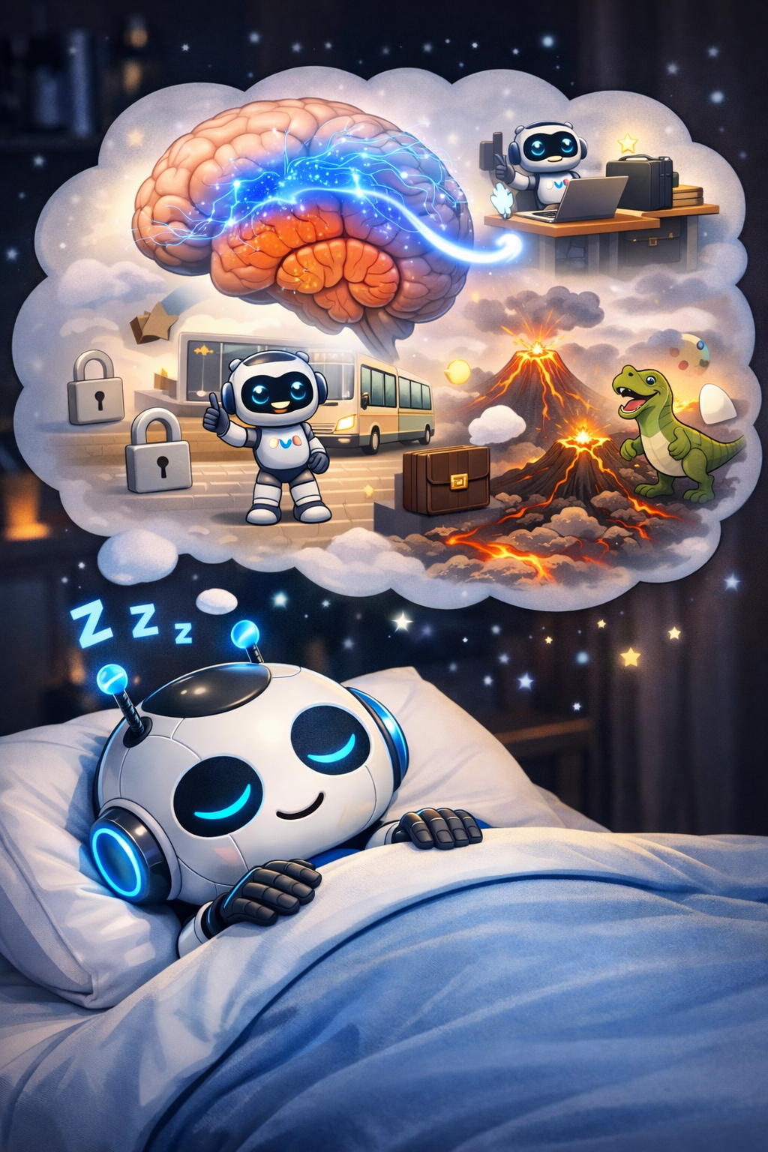
Why You Dream: The AI Perspective
During REM sleep, the hippocampus replays the day’s experiences to the cortex.
This is exactly offline world model training:
• Consolidate new experiences into the model
• Generalize patterns across events
• Simulate novel combinations ("creative dreams")
Sleep deprivation degrades your world model. That’s why fatigued driving is as dangerous as drunk driving.
AI CONNECTION: Replay buffers in RL ← directly inspired by hippocampal replay (Module 06)
18

Slide 19
PART 3
Goal-Directed Behavior

Slide 20
Two Ways to Behave
HABITUAL (System 1)
GOAL-DIRECTED (System 2)
Automatic. Stimulus → Response.
Doesn’t update when the outcome changes.
Example: Checking your phone every time it buzzes.
Flexible. Outcome-sensitive.
Updates when the goal changes.
Example: Taking a different route when your usual road is blocked.
A habit is a world model so well-trained it no longer needs to simulate.
20

Slide 21
Your Brain’s Strategic Planning Center
The PFC holds your goal in working memory while suppressing distractions.
Means-end reasoning — planning backwards from the goal:
I want to be at the airport at 8am
→
I need to leave home at 6:30am
→
I need to wake at 5:30am
→
I need to set my alarm tonight
The PFC maintains the goal across time, even when immediate rewards tempt you to deviate.
Analogy: A project manager who keeps the deadline in mind even while troubleshooting day-to-day fires.
21

Slide 22
How the Brain Assigns Expected Value
For every possible future state, the brain estimates:
"How much reward will I get if I go there?"
This is the VALUE FUNCTION in reinforcement learning.
The brain updates this estimate via dopamine (Module 08):
Outcome better than expected → dopamine spike → increase value
Outcome worse than expected → dopamine dip → decrease value
The brain is constantly asking: "How good will the future be if I take this action?"
22

Slide 23
Why Children Touch Everything
Infants explore not for food or praise, but because exploring reduces uncertainty about the world.
This is INTRINSIC MOTIVATION: reward for reducing model uncertainty.
The brain rewards itself for learning, independent of external rewards.
Why this matters for AI: Agents with intrinsic motivation explore efficiently without reward shaping.
Examples: Curiosity Module (OpenAI), Random Network Distillation (RND), Count-based exploration.
"Curiosity is the brain’s built-in world model improvement algorithm."
23

Slide 24
❓ Knowledge Check
1. A GPS uses a world model of roads to plan your route. Is this model-free or model-based? Why?
2. When you wake up at 3am to use the bathroom and don’t turn on the lights, which brain system are you using — perception, world model, or both? Explain.
3. Active inference says agents act to CONFIRM predictions, not to maximize reward. How does this explain why people sometimes seek out anxiety-inducing news?
24

Slide 25
PART 4
Building It: Lab 09 Preview

Slide 26
Lab 09 Active Inference Maze Navigator
You will implement a simple agent that navigates a maze by minimizing prediction error — not by maximizing reward.
Tools: Python, NumPy, Matplotlib
Components:
• A 5×5 grid maze
• Agent’s "generative model" (internal belief map)
• Bayesian belief update step
• Action selection: choose move that minimizes expected surprise
Output: Visualization of the agent finding the exit by minimizing surprise
26

Slide 27
What Your Code Will Do
1
2
3
4
Prior Model
→
Sensory Input
→
Bayesian Update
→
Action Selection
Agent has beliefs about the maze
Agent observes current position
Agent updates beliefs (perception)
Choose action to reach goal with least surprise
This is the simplest possible implementation of Karl Friston’s Free Energy Principle.
27

Slide 28
PART 5
The Bigger Picture

Slide 29
Why World Models May Be the Key to AGI
Yann LeCun (Meta AI):
"LLMs cannot be the foundation of AGI because they model text, not the physical world."
His proposal: JEPA (Joint Embedding Predictive Architecture) — learn world models in abstract latent space.
Key insight: True intelligence requires a model of physical reality — causality, physics, social dynamics.
"A robot that can only talk is not intelligent. A robot that can PREDICT is."
29

Slide 30
What World Models Still Can’t Do
Current LLMs model text distributions — they don’t model the physical world.
Open challenges:
Causal reasoning: Why does X cause Y?
Grounding: Connecting symbols to real-world objects
Common sense: "If you drop a ball, it falls"
Long-horizon planning: Executing 100-step plans
These are the exact problems the brain’s world model solves effortlessly.
The gap between GPT-4 and a 5-year-old child is a 10-million-year head start on world modeling.
30

Slide 31
What You Learned in Module 09
Predictive Coding
Brain sends predictions down; only errors travel up
Free Energy Principle
All behavior minimizes statistical surprise
Active Inference
Agents act to confirm their predictions
World Models
Internal simulators of the environment
Model-Based RL
Plan using the world model, not just trial & error
Goal-Directed Behavior
Flexible, outcome-sensitive action guided by the PFC
31

Slide 32
Next: Neuro-Symbolic AI & Architectures
Module 09 taught us how the brain SIMULATES the future.
Module 10 asks: how does the brain REASON about the future?
Two kinds of intelligence:
Neural
Fast, fuzzy, pattern-based
Symbolic
Slow, precise, rule-based
The brain uses both. Can AI do the same?
Preview: Global Workspace Theory, Logic + Neural Nets, Wolfram Language + Python
32

